Slide 1

Dosbarth Mr Brooks and Mrs Evans

Slide 2
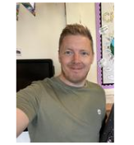
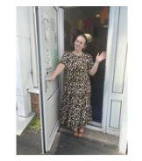
Mrs Evans
I will be your teacher.
I love to go for walks on the beach!
I really enjoy outdoor learning.
I will be your teacher.
I have two cats, called Ivy & Nova.
I really enjoy teaching and like to have lots of fun, especially during our sensory sessions.
What do you like doing in school?
Who lives in your house?
Mr Brooks

Slide 3
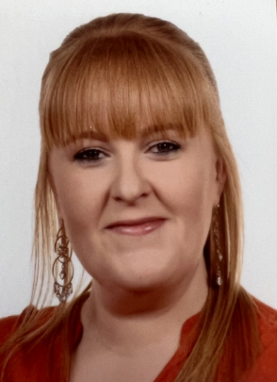
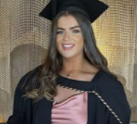
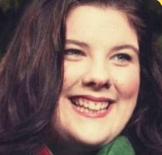
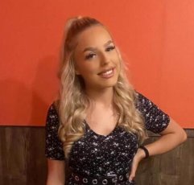
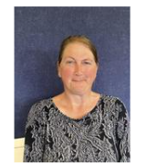
Our Teaching Assistants in our class are: Miss Simons, Miss Ward, Miss Evans, Miss Salisbury and Ms Botto. They will be helping us with our learning. You will see them in the classroom and on the yard. They will come with us on trips too.
Miss Ward
Miss Simons
Miss Evans
Miss Salisbury
Mrs Botto

Slide 4
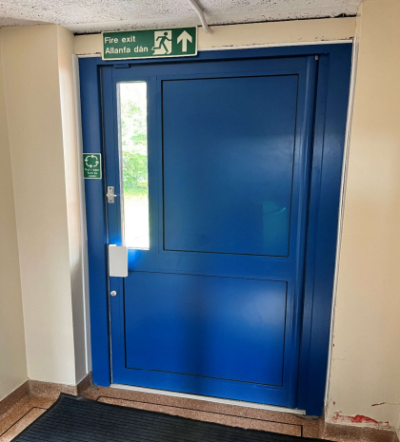
This is where you come in in the morning.

Slide 5
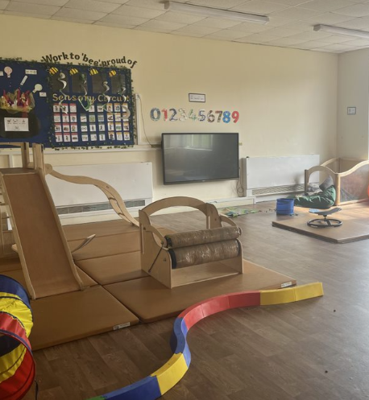
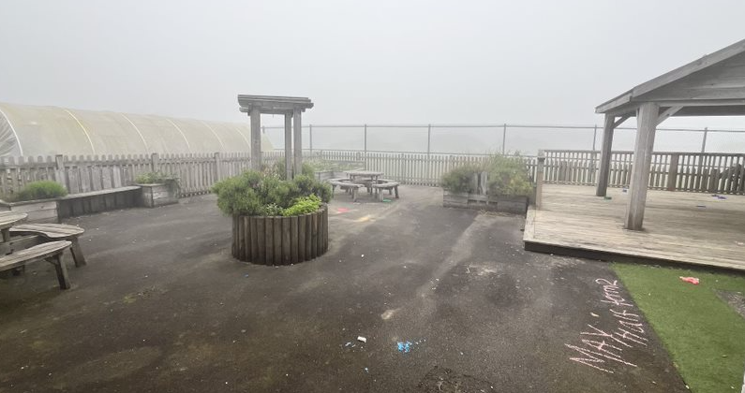
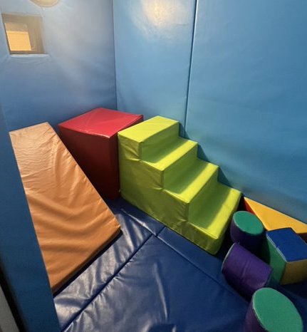
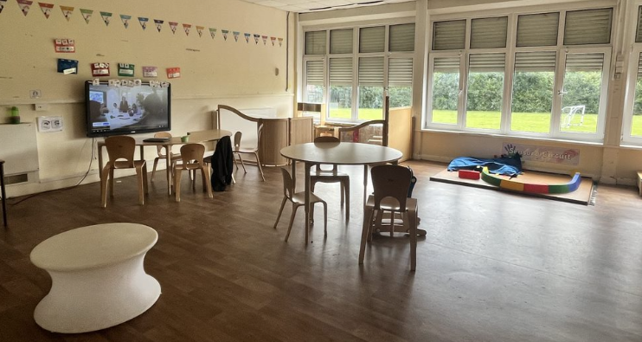
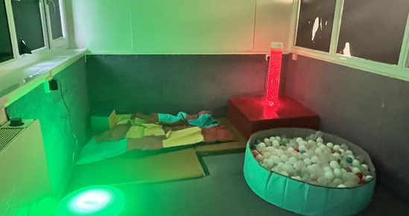
This is where we learn.
Mrs Evans' Class
Mr Brooks' Class

Slide 6
We can’t wait to teach you! Have a wonderful Summer Holiday and I look forward to seeing you in September ☺
From
Mrs Evans and Mr Brooks

